Slide 1

THE
KOREAN
VOWELS
Notes:
Hello and welcome to the second video. In this video, you will learn the basic eight Korean vowels. Do you know what a vowel is? In very simple terms, it is a sound produced with your mouth open. In English the vowels are “a”, “e”, “i”, “o”, “u”, and “y”. You can pronounce them with your mouth open the whole time, right? Whereas the other letters, the consonant, require some kind of obstruction. Try saying the letter b and you will notice that your lips touch at the beginning. That’s the main difference between vowels and consonants. [click]

Slide 2
OBJECTIVE
01
To be able to recognize Hangul
Notes:
By the end of this video, you will be able to recognize Hangeul among other kinds of writing systems. [click]

Slide 3
OBJECTIVE
02
To be able to read individual Hangul vowels
Notes:
By the end of this video, you will also be able to read the eight basic Korean vowels! Let’s get started.

Slide 4
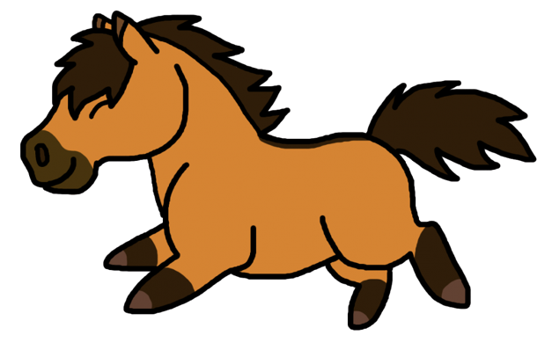
Which one is Korean?
马
말
馬
Chinese
Korean
Japanese
Notes:
As we have discussed before, Korean is an alphabet, while Chinese characters are ideograms. Here are three different writing systems, each spelling the word “horse”. One of them is Korean of course, while the two others are Chinese and Japanese. Can you guess which is which? You win if you can pick out the Korean. As a hint, remember that Hangeul is an alphabet with one character representing one sound. The word “horse” is pronounced “mal” in Korean and is written with three letters. Just like in English, Korean letters are separated by spaces. Have you figured out which one is Korean? The one one the left is Chinese, or rather a simplified Chinese characters that is used in Chinese today. Korean is the middle one, with three distinct letters. [click] m, a, and l. Finally, Japanese uses three different writing systems, but without going into the details, they use the traditional Chinese character to write the word horse, exactly like Koreans used to before switching to the Hangeul! [click]

Slide 5
STRAIGHT LINES EVERYWHERE
eu
o
i
Notes:
You might have also noticed that the Korean letters are highly geometrical, mostly made of straight lines. This makes it very easy to learn Hangeul! As an example, here are your first three Korean vowels to learn. “I” is a straight vertical line, “eu” is a straight horizontal line, and “o” is a short straight vertical line attached to a long straight horizontal line. Not too complicated compared to Chinese characters, am I right? [click]

Slide 6
VOWEL ORIENTATION
eu
o
i
Notes:
There is a reason why I keep mentioning the words horizontal and vertical. This is because it will matter when we start combining letters. In Korean, vowels can be either vertical, meaning “standing up” or horizontal, meaning laying flat down. “I” is a vertical vowel, while “eu” and “o” are horizontal vowels. You know that by looking at the long bar of each vowel, it is what decides their orientation. [click]

Slide 7
THE 8 BASIC VOWELS
vertical
a
i
eo
ae
e
horizontal
eu
o
u
Notes:
Let’s take a look at all eight basic vowels now. The green ones are the vertical ones and the blue ones are the horizontal ones. Let’s pronounce them all one by one. “a”, “I”, “eo”, “ae”, “e”, “eu”, “o”, “u”. Observe the long bar or long bars in each letter, this is how you can decide whether they are horizontal or vertical vowels. Before we move on, I want to clarify that the last two vowels in the top row are pronounced the same “e”, despite one being written as “ae” and the other as plain “e”. They used to be pronounced different a long time ago, but now they are pronounced exactly the same. [click]

Slide 8
ieung ㅇ
apricot
a
u
Notes:
Here is the letter for “a”, a vertical vowel. There is an interesting rule in Korean that doesn’t exist in English and that states that vowels can never be alone. They always need to have a consonant coming before them. So instead of writing just a, we add a silent consonant in front of it called ieung. It’s basically just a circle. As a silent letter, it is not pronounced and is just here to keep company to the vowel. Let’s see what that means in context. In English a vowel can start a word, like in the word “apricot” with the “a” at the front. But in Korean, we couldn’t have that vowel standing there all alone at the beginning of the word, so we would add the consonant ieung before it. It would still be read apricot, but the vowel is not alone anymore. When the vowel is vertical like “a” here, the consonant goes to its left. However, and that’s where it gets interesting, if the vowel is horizontal, then the consonant goes on top of it! Like for the vowel “u” here. [next slide]

Slide 9
ieung ㅇ
a
i
eo
ae
e
eu
o
u
Notes:
Here are the eight vowels represented with ieung. From now on in this course we will always write the vowels with ieung rather than on their own as you will never see them without a consonant when reading in Korean anyway. Let’s read them one more time before ending this video. “a”, “i”, “eo”, “ae”, “e”, “eu”, “o”, “u”. See you in the next video! [click][end of video]

